Slide 1
Water Cycle Dice Game
To be used with the “Where is the Water?” series of posters (watercycle.byu.edu)
Ryan S. Nixon, Sophie Hill Brigham Young University January 2023

Slide 2
Surface Water

Slide 3
Groundwater

Slide 4
Atmosphere

Slide 5
Plants

Slide 6
Animals

Slide 7
City Water System
No Forest

Slide 8
Factories
No Desert, Forest

Slide 9
Ocean
Coastal Only

Slide 10
Suburban

Slide 11
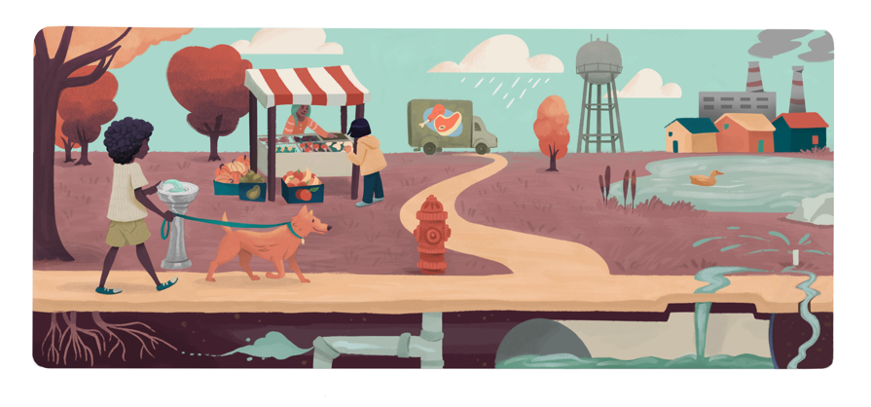
Surface Water
Roll | What happened | Go to
1 | Soaks deep into the ground | Groundwater
2 | Wastewater piped into a treatment plant | City water system
3 | Heated by the sun and evaporates | Atmosphere
4 | Used for irrigation, helps plants grow | Plants
5 | Stormwater piped to nearby river or stream | Surface water
6 | Drank by a thirsty animal | Animals
Suburban

Slide 12
Groundwater
Roll | What happened | Go to
1 | Sinks deeper into the soil | Groundwater
2 | Seeps into small cracks in bedrock | Groundwater
3 | Stays underground as part of a deep aquifer | Groundwater
4 | City wells dug deep into the earth pull water up for human use | City water system
5 | City wells dug deep into the earth pull water up for human use | City water system
6 | Wells for individual homes pull water from shallow aquifers for individual homeowner use | City water system
Suburban

Slide 13
Atmosphere
Roll | What happened | Go to
1 | Rains | Surface water
2 | Pulled higher into the sky | Atmosphere
3 | Blown along above the earth | Atmosphere
4 | Rains and goes down the gutter | Surface water
5 | Rains and soaks into the ground | Groundwater
6 | No rain. Roll again.
Suburban

Slide 14
Plants
Roll | What happened | Go to
1 | Plants retain some of the water they absorb | Plants
2 | Eaten by an animal while it was in a plant | Animals
3 | Released into the air as plants decompose | Atmosphere
4 | Released into the air as the plant grows | Atmosphere
5 | Released into the air as the plant grows | Atmosphere
6 | Released into the air as the plant grows | Atmosphere
Suburban

Slide 15
Animals
Roll | What happened | Go to
1 | Animals get eaten by other animals | Animals
2 | Animals retain some of the water they consume | Animals
3 | Water released in animal waste outdoors | Surface water
4 | Water released in animal waste outdoors | Surface water
5 | Water released in animal waste indoors | City water system
6 | Released into the air as animals decompose | Atmosphere
Suburban

Slide 16
City Water System
Roll | What happened | Go to
1 | Used to water lawns | Surface water
2 | Used to water lawns | Surface water
3 | Used to water lawns and evaporates in the process | Atmosphere
4 | Used in homes after treatment | City water system
5 | Treated to be used in factories | Factories
6 | Roll again.
Suburban

Slide 17
Factories
Roll | What happened | Go to
1 | Dumped back into surface water, potentially polluted | Surface water
2 | Water heated to steam to generate electricity or run machines is released into the air | Atmosphere
3 | Reused for multiple uses within the factory | Factories
4 | Used to make clothing, released to be treated | City water system
5 | Roll again.
6 | Roll again.
Suburban

Slide 18
Desert

Slide 19
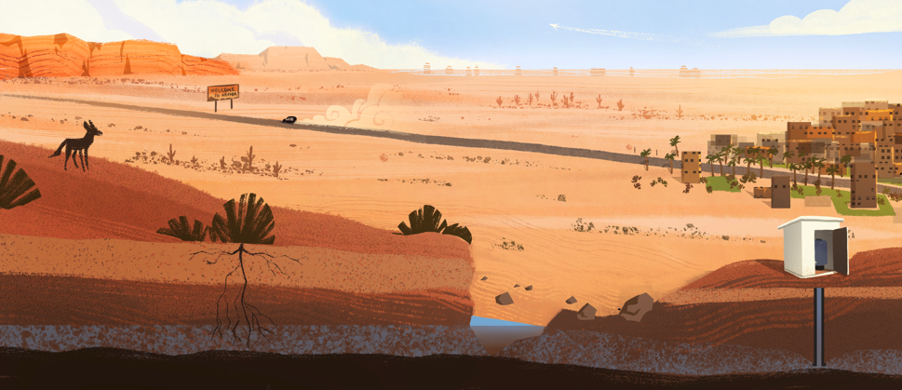
Surface Water
Roll | What happened | Go to
1 | Heated by the sun and evaporates | Atmosphere
2 | Heated by the sun and evaporates | Atmosphere
3 | Soaks deep into the ground | Groundwater
4 | Helps plants grow | Plants
5 | No water on surface. Roll again.
6 | No water on surface. Roll again.
Desert

Slide 20
Groundwater
Roll | What happened | Go to
1 | Sinks deeper into the soil | Groundwater
2 | Seeps into small cracks in bedrock | Groundwater
3 | Stays underground as part of a deep aquifer | Groundwater
4 | Wells dug deep into the earth pull water up for human use | City water system
5 | Periodically reaches the surface as springs | Surface water
6 | Plants grow roots deep into the ground to reach groundwater sources | Plants
Desert

Slide 21
Atmosphere
Roll | What happened | Go to
1 | Rains infrequently | Surface water
2 | Rains infrequently | Surface water
3 | Rains but doesn’t make it to the ground | Atmosphere
4 | No rain. Roll again.
5 | No rain. Roll again.
6 | No rain. Roll again.
Desert

Slide 22
Plants
Roll | What happened | Go to
1 | Plants retain some of the water they absorb | Plants
2 | Plants retain some of the water they absorb | Plants
3 | Plants retain some of the water they absorb | Plants
4 | Eaten by an animal while it was in a plant | Animals
5 | Desert plants release minimal water back into the air | Atmosphere
6 | Irrigated plants release water back into the air as the plant grows | Atmosphere
Desert

Slide 23
Animals
Roll | What happened | Go to
1 | Animals get eaten by other animals | Animals
2 | Animals retain some of the water they consume | Animals
3 | Animals retain some of the water they consume | Animals
4 | Water released in animal waste outdoors | Surface water
5 | Water released in animal waste outdoors | Surface water
6 | Released into the air as animals decompose | Atmosphere
Desert

Slide 24
City Water System
Roll | What happened | Go to
1 | Used to water lawns | Surface water
2 | Used to water lawns | Surface water
3 | Used to water lawns and evaporates in the process | Atmosphere
4 | Used in homes after treatment | City water system
5 | Used in homes after treatment | City water system
6 | Roll again.
Desert

Slide 25
Urban

Slide 26
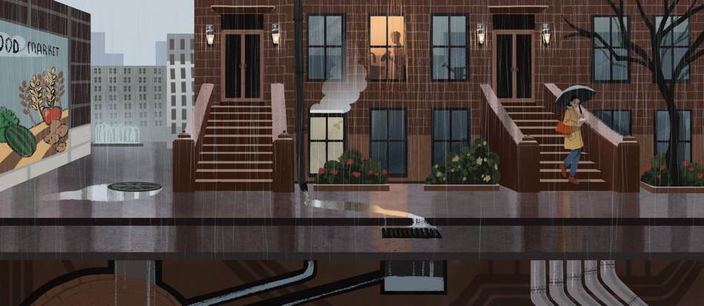
Surface Water
Roll | What happened | Go to
1 | Soaks into the ground through exposed soil | Groundwater
2 | Drank by a thirsty animal | Animals
3 | Heated by the sun and evaporates | Atmosphere
4 | Stormwater piped to nearby river or stream | Surface water
5 | Stormwater piped to nearby river or stream | Surface water
6 | Stormwater piped to nearby river or stream | Surface water
Urban

Slide 27
Groundwater
Roll | What happened | Go to
1 | Sinks deeper into the soil | Groundwater
2 | City wells dug deep into the earth pull water up for human use | City water system
3 | City wells dug deep into the earth pull water up for human use | City water system
4 | City wells dug deep into the earth pull water up for human use | City water system
5 | City wells dug deep into the earth pull water up for human use | City water system
6 | Wells for individual homes pull water from shallow aquifers for individual homeowner use | City water system
Urban

Slide 28
Atmosphere
Roll | What happened | Go to
1 | Rains and goes down the gutter | Surface water
2 | Rains and goes down the gutter | Surface water
3 | Pulled higher into the sky | Atmosphere
4 | Blown along above the earth | Atmosphere
5 | Rains and soaks into the ground | Groundwater
6 | No rain. Roll again.
Urban

Slide 29
Plants
Roll | What happened | Go to
1 | Plants retain some of the water they absorb | Plants
2 | Plants retain some of the water they absorb | Plants
3 | Released into the air as leaf litter decomposes | Atmosphere
4 | Released into the air as the plant grows | Atmosphere
5 | Released into the air as the plant grows | Atmosphere
6 | No plants. Roll Again.
Urban

Slide 30
Animals
Roll | What happened | Go to
1 | Animals get eaten by other animals | Animals
2 | Animals retain some of the water they consume | Animals
3 | Water released in animal waste outdoors | Surface water
4 | Water released in animal waste outdoors | Surface water
5 | Water released in animal waste outdoors | Surface water
6 | Water released in animal waste indoors | City water system
Urban

Slide 31
City Water System
Roll | What happened | Go to
1 | Used to water lawns | Surface water
2 | Used to water lawns | Surface water
3 | Used to water lawns and evaporates in the process | Atmosphere
4 | Treated to be used in factories | Factories
5 | Used in homes after treatment | City water system
6 | Water recycled | City water system
Urban

Slide 32
Factories
Roll | What happened | Go to
1 | Dumped back into surface water, potentially polluted | Surface water
2 | Dumped back into surface water, potentially polluted | Surface water
3 | Reused for multiple uses within the factory | Factories
4 | Used to make clothing, released to be treated | City water system
5 | Water heated to steam to generate electricity or run machines is released into the air | Atmosphere
6 | Water heated to steam to generate electricity or run machines is released into the air | Atmosphere
Urban

Slide 33
Agricultural

Slide 34
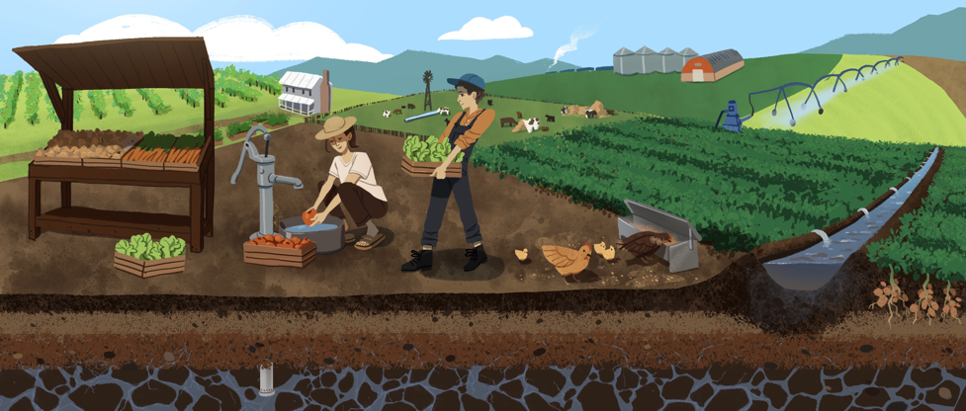
Surface Water
Roll | What happened | Go to
1 | Soaks deep into the ground | Groundwater
2 | Heated by the sun and evaporates | Atmosphere
3 | Used for irrigation, helps plants grow | Plants
4 | Used for irrigation, helps plants grow | Plants
5 | Runoff piped to nearby river or stream, often polluted with fertilizers or pesticides | Surface water
6 | Drank by a thirsty animal | Animals
Agricultural

Slide 35
Groundwater
Roll | What happened | Go to
1 | Sinks deeper into the soil | Groundwater
2 | Seeps into small cracks in bedrock | Groundwater
3 | Stays underground as part of a deep aquifer | Groundwater
4 | Individual wells dug deep into the earth pull water up for agricultural use | Surface Water
5 | Individual wells dug deep into the earth pull water up for agricultural use | Surface Water
6 | Wells for individual homes pull water from shallow aquifers for individual homeowner use | City water system
Agricultural

Slide 36
Atmosphere
Roll | What happened | Go to
1 | Rains and is taken up by plants | Plants
2 | Pulled higher into the sky | Atmosphere
3 | Blown along above the earth | Atmosphere
4 | Rains and goes down the gutter | Surface water
5 | Rains and soaks into the ground | Groundwater
6 | No rain. Roll again.
Agricultural

Slide 37
Plants
Roll | What happened | Go to
1 | Plants retain some of the water they absorb | Plants
2 | Eaten by an animal while it was in a plant | Animals
3 | Released into the air as plants decompose | Atmosphere
4 | Released into the air as the plant grows | Atmosphere
5 | Released into the air as the plant grows | Atmosphere
6 | Released into the air as the plant grows | Atmosphere
Agricultural

Slide 38
Animals
Roll | What happened | Go to
1 | Animals get eaten by other animals | Animals
2 | Animals retain some of the water they consume | Animals
3 | Animals retain some of the water they consume | Animals
4 | Water released in animal waste outdoors | Surface water
5 | Water released in animal waste outdoors | Surface water
6 | Released into the air as animals decompose | Atmosphere
Agricultural

Slide 39
City Water System
Roll | What happened | Go to
1 | Used to water lawns | Surface water
2 | Used to water lawns and evaporates in the process | Atmosphere
3 | Used to water lawns and evaporates in the process | Atmosphere
4 | Used in homes after treatment | City water system
5 | Treated to be used in factories | Factories
6 | Allowed to soak into the ground in a septic field | Groundwater
Agricultural

Slide 40
Farms? Transportation?
Roll | What happened | Go to
1 | Dumped back into surface water, potentially polluted | Surface water
2 | Water heated to steam to generate electricity or run machines is released into the air | Atmosphere
3 | Reused for multiple uses within the factory | Factories
4 | Used to make clothing, released to be treated | City water system
5 | Roll again.
6 | Roll again.
Agricultural

Slide 41
Forest

Slide 42
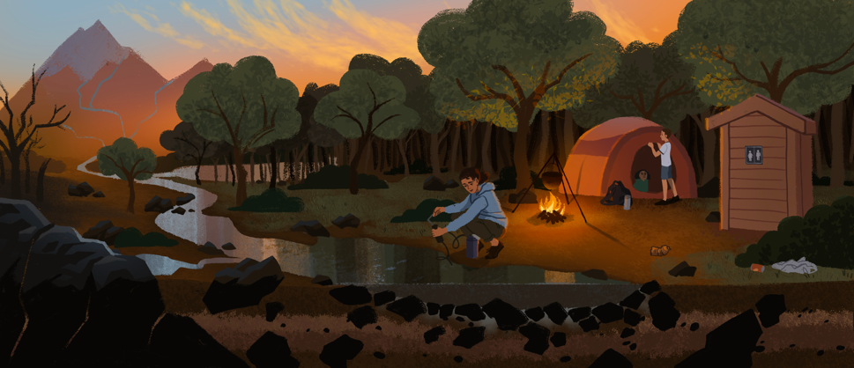
Surface Water
Roll | What happened | Go to
1 | Soaks deep into the ground | Groundwater
2 | Soaks deep into the ground | Groundwater
3 | Heated by the sun and evaporates | Atmosphere
4 | Helps plants grow | Plants
5 | Flows to nearby river or stream | Surface water
6 | Drank by a thirsty animal | Animals
Forest

Slide 43
Groundwater
Roll | What happened | Go to
1 | Sinks deeper into the soil | Groundwater
2 | Seeps into small cracks in bedrock | Groundwater
3 | Stays underground as part of a deep aquifer | Groundwater
4 | Shallow wells dug into the earth pull water up for human use | Surface water
5 | Natural springs bring water up to the surface, could be hot water | Surface water
6 | Natural springs bring water up to the surface, could be hot water | Surface water
Forest

Slide 44
Atmosphere
Roll | What happened | Go to
1 | Rains and is taken up by plants | Plants
2 | Pulled higher into the sky | Atmosphere
3 | Blown along above the earth | Atmosphere
4 | Rains and flows down stream | Surface water
5 | Rains and soaks into the ground | Groundwater
6 | No rain. Roll again.
Forest

Slide 45
Plants
Roll | What happened | Go to
1 | Plants retain some of the water they absorb | Plants
2 | Eaten by an animal while it was in a plant | Animals
3 | Released into the air as plants decompose | Atmosphere
4 | Released into the air as the plant grows | Atmosphere
5 | Released into the air as the plant grows | Atmosphere
6 | Released into the air as the plant grows | Atmosphere
Forest

Slide 46
Animals
Roll | What happened | Go to
1 | Animals get eaten by other animals | Animals
2 | Animals retain some of the water they consume | Animals
3 | Animals retain some of the water they consume | Animals
4 | Water released in animal waste outdoors | Surface water
5 | Water released in human waste via septic systems | Groundwater
6 | Released into the air as animals decompose | Atmosphere
Forest

Slide 47
Coastal

Slide 48
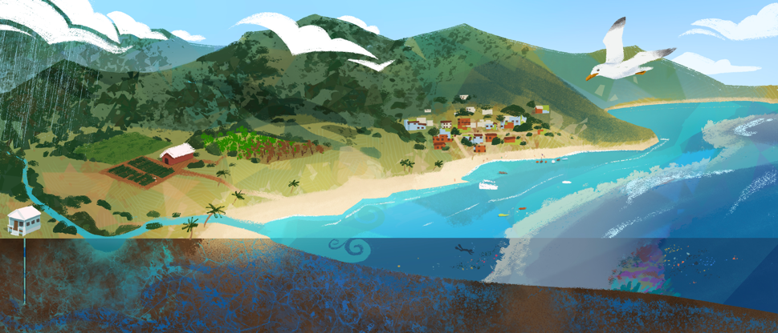
Surface Water
Roll | What happened | Go to
1 | Soaks into the ground | Groundwater
2 | Flows into the ocean | Ocean
3 | Heated by the sun and evaporates | Atmosphere
4 | Used for irrigation, helps plants grow | Plants
5 | Flows to a nearby river or stream | Surface water
6 | Drank by a thirsty animal | Animals
Coastal

Slide 49
Groundwater
Roll | What happened | Go to
1 | Sinks deeper into the soil | Groundwater
2 | Flows horizontally to mix with ocean water | Ocean
3 | Stays underground as part of a deep saline aquifer | Groundwater
4 | Shallow wells dug into the earth pull water up for human use | City water system
5 | Fresh water mixes with saltwater and becomes unusable | Groundwater
6 | Fresh water mixes with saltwater and becomes unusable | Groundwater
Coastal

Slide 50
Atmosphere
Roll | What happened | Go to
1 | Rains over the ocean | Ocean
2 | Pulled higher into the sky | Atmosphere
3 | Blown along above the earth | Atmosphere
4 | Rains and flows to a river or stream | Surface water
5 | Rains and soaks into the ground | Groundwater
6 | No rain. Roll again.
Coastal

Slide 51
Plants
Roll | What happened | Go to
1 | Plants retain some of the water they absorb | Plants
2 | Eaten by an animal while it was in a plant | Animals
3 | Released into the air as plants decompose | Atmosphere
4 | Released into the air as the plant grows | Atmosphere
5 | Released into the air as the plant grows | Atmosphere
6 | Released into the air as the plant grows | Atmosphere
Coastal

Slide 52
Animals
Roll | What happened | Go to
1 | Animals get eaten by other animals | Animals
2 | Animals retain some of the water they consume | Animals
3 | Water released in animal waste outdoors | Surface water
4 | Water released in animal waste underwater | Ocean
5 | Water released in animal waste indoors | City water system
6 | Released into the air as animals decompose | Atmosphere
Coastal

Slide 53
City Water System
Roll | What happened | Go to
1 | Used to water lawns | Surface water
2 | Used to water crops | Plants
3 | Used to water lawns and evaporates in the process | Atmosphere
4 | Used in homes after treatment | City water system
5 | Treated to be used in factories | Factories
6 | Roll again.
Coastal

Slide 54
Ocean
Roll | What happened | Go to
1 | Water remains in ocean | Ocean
2 | Water remains in ocean | Ocean
3 | Water evaporates into the atmosphere | Atmosphere
4 | Water evaporates into the atmosphere | Atmosphere
5 | Salt is removed from seawater in desalinization plants | City water system
6 | Water is used by ocean creatures | Animals
Coastal

